Slide 1
Chapter 1
The Logic of Compound Statements

Slide 2
Section 1.5
Number Systems and Circuits for Addition
Karnaugh Maps

Slide 3
Decimal Representation
Recall decimal numbers (base 10) can be described as a number sentence.
Decimal: 6,145 == 6x1000 + 1x100 + 4x10 + 5
6x10³ + 1x10² + 4x10¹ + 5x10⁰
Decimal: 7,000 == 7x1000 + 0x100 + 0x10 + 0
7x10³ + 0x10² + 0x10¹ + 0x10⁰

Slide 4
Binary Representation
Binary numbers (base 2) are sequence of {0,1}digits. The value of the number depends on it’s location in the sequence.
Binary: 1101 => 1x8 + 1x4 + 0x2 + 1
1x2³ + 1x2² + 1x2¹ + 1x2⁰
= (decimal) 8+4+0+1 = 13₁₀
Binary: 10101 => 1x16 + 0x8 + 1x4 + 0x2 + 1
1x2⁴ + 0x2³ + 1x2² + 1x2¹ + 1x2⁰
= (decimal) 16+0+4+0+1 = 21₁₀

Slide 5
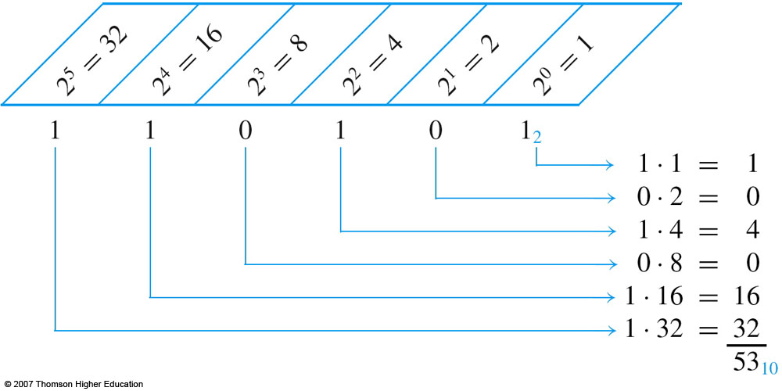
Converting Binary to Decimal
Converting from binary to decimal is performed by expanding the binary to a number sentence and summing over the number sentence.
Example:
110101₂ = 1x2⁵ + 1x2⁴ + 0x2³ + 1x2² + 0x2¹ + 1x2⁰ = 53₁₀

Slide 6
Converting Decimal to Binary
Convert decimal to binary using the repeated division method as follows. The divisor (bottom number) is the base that the decimal is being converted to.
Example: Convert 50₁₀ to binary
50₁₀ = 110010₂

Slide 7
Example
Convert 209₁₀ to binary
Answer: 11010001

Slide 8
Binary Addition
Binary addition is performed in the same manner as decimal addition.
When and how do you perform a carry?
Carry is dependent on the base. Sum greater than the (base – 1) results in a carry.
Example:
1₂ + 0₂ = 1 (no carry)
0₂ + 1₂ = 1 (no carry)
1₂ + 1₂ = 10₂ (carry)

Slide 9
Examples

Slide 10
Binary Subtraction
Binary subtraction is performed in the same manner as decimal subtraction.
When and how do you perform a borrow?
Borrow is dependent on the base. In decimal you borrow a 10’s value from the adjoining digit, however, in binary you borrow a 10₂ (2₁₀).
Example:
1₂ - 0₂ = 1 (no borrow)
1₂ - 1₂ = 0 (no borrow)
10₂ - 1₂ = 01₂ (borrow from 2’s position)
2₁₀ – 1₁₀ = 1₁₀ (check)

Slide 11
Examples

Slide 12
Circuits for Addition
Addition requires two inputs (P, Q) and two outputs (Carry, Sum).
Input/output table can be constructed to show the relationship of P,Q to Carry and P,Q to Sum.

Slide 13
Addition Circuits Half-Adder

Slide 14
Addition Circuits Full-Adder
A full adder requires three inputs, (P, Q) and a carry in (R).
Notes:
Use canonical form to create circuit

Slide 15
Addition Circuits Full-Adder
Full-adder can be constructed from multiple half-adders.
Notes:
Use canonical form to create circuit

Slide 16
Addition Circuits Full-Adder
Full-adder can be constructed from two half-adders.
Notes:
Use canonical form to create circuit

Slide 17
Unsigned Integers
Non-positional notation
could represent a number (“5”) with a string of ones (“11111”)
problems?
Weighted positional notation
like decimal numbers: “329”
“3” is worth 300, because of its position, while “9” is only worth 9
most
significant
least
significant
329
101
10²
10¹
10⁰
2²
2¹
2⁰
3x100 + 2x10 + 9x1 = 329
1x4 + 0x2 + 1x1 = 5

Slide 18
Unsigned Integers (cont.)
An n-bit unsigned integer represents 2^{n} values: from 0 to 2^{n}-1.
2² | 2¹ | 2⁰
0 | 0 | 0 | 0
0 | 0 | 1 | 1
0 | 1 | 0 | 2
0 | 1 | 1 | 3
1 | 0 | 0 | 4
1 | 0 | 1 | 5
1 | 1 | 0 | 6
1 | 1 | 1 | 7

Slide 19
Signed Integers
With n bits, we have 2^{n} distinct values.
assign about half to positive integers (1 through 2^{n-1}) and about half to negative (- 2^{n-1} through -1)
that leaves two values: one for 0, and one extra
Positive integers
just like unsigned – zero in most significant (MS) bit 00101 = 5
Negative integers
sign-magnitude – set MS bit to show negative, other bits are the same as unsigned 10101 = -5
one’s complement – flip every bit to represent negative 11010 = -5
in either case, MS bit indicates sign: 0=positive, 1=negative

Slide 20
Two’s Complement
Problems with sign-magnitude and 1’s complement
two representations of zero (+0 and –0)
arithmetic circuits are complex
How to add two sign-magnitude numbers?
e.g., try 2 + (-3)
How to add to one’s complement numbers?
e.g., try 4 + (-3)
Two’s complement representation developed to make circuits easy for arithmetic.
for each positive number (X), assign value to its negative (-X), such that X + (-X) = 0 with “normal” addition, ignoring carry out
00101 (5) 01001 (9)
+ 11011 (-5) + (-9)
00000 (0) 00000 (0)

Slide 21
Two’s Complement Representation
If number is positive or zero,
normal binary representation, zeroes in upper bits if required.
If number is negative,
start with positive number
flip every bit (i.e., take the one’s complement)
then add one
00101 (5) 01001 (9)
11010 (1’s comp) (1’s comp)
+ 1 + 1
11011 (-5) (-9)

Slide 22
Two’s Complement Shortcut
To take the two’s complement of a number:
copy bits from right to left until (and including) the first “1”
flip remaining bits to the left
011010000 011010000
100101111 (1’s comp)
+ 1
100110000 100110000
(flip)
(copy)

Slide 23
Two’s Complement Signed Integers
MS bit is sign bit – it has weight –2^{n-1}.
Range of an n-bit number: -2^{n-1} through 2^{n-1} – 1.
The most negative number (-2^{n-1}) has no positive counterpart.
-2³ | 2² | 2¹ | 2⁰
0 | 0 | 0 | 0 | 0
0 | 0 | 0 | 1 | 1
0 | 0 | 1 | 0 | 2
0 | 0 | 1 | 1 | 3
0 | 1 | 0 | 0 | 4
0 | 1 | 0 | 1 | 5
0 | 1 | 1 | 0 | 6
0 | 1 | 1 | 1 | 7
-2³ | 2² | 2¹ | 2⁰
1 | 0 | 0 | 0 | -8
1 | 0 | 0 | 1 | -7
1 | 0 | 1 | 0 | -6
1 | 0 | 1 | 1 | -5
1 | 1 | 0 | 0 | -4
1 | 1 | 0 | 1 | -3
1 | 1 | 1 | 0 | -2
1 | 1 | 1 | 1 | -1

Slide 24
Converting Binary (2’s C) to Decimal
If leading bit is one, take two’s complement to get a positive number.
Add powers of 2 that have “1” in the corresponding bit positions.
If original number was negative, add a minus sign.
n | 2^{n}
0 | 1
1 | 2
2 | 4
3 | 8
4 | 16
5 | 32
6 | 64
7 | 128
8 | 256
9 | 512
10 | 1024
X = 01101000₂
= 2⁶+2⁵+2³ = 64+32+8
= 104₁₀
Assuming 8-bit 2’s complement numbers.

Slide 25
More Examples
X = 00100111₂
= 2⁵+2²+2¹+2⁰ = 32+4+2+1
= 39₁₀
n | 2^{n}
0 | 1
1 | 2
2 | 4
3 | 8
4 | 16
5 | 32
6 | 64
7 | 128
8 | 256
9 | 512
10 | 1024
X = 11100110₂
-X = 00011010
= 2⁴+2³+2¹ = 16+8+2
= 26₁₀
X = -26₁₀
Assuming 8-bit 2’s complement numbers.

Slide 26
Converting Decimal to Binary (2’s C)
First Method: Division
Find magnitude of decimal number. (Always positive.)
Divide by two – remainder is least significant bit.
Keep dividing by two until answer is zero, writing remainders from right to left.
Append a zero as the MS bit; if original number was negative, take two’s complement.
X = 104_{ten} 104/2 = 52 r0 bit 0
52/2 = 26 r0 bit 1
26/2 = 13 r0 bit 2
13/2 = 6 r1 bit 3
6/2 = 3 r0 bit 4
3/2 = 1 r1 bit 5
X = 01101000_{two} 1/2 = 0 r1 bit 6

